Slide 1

There is a Time and Place for Everything
John Morehouse Rob sewell

Slide 2
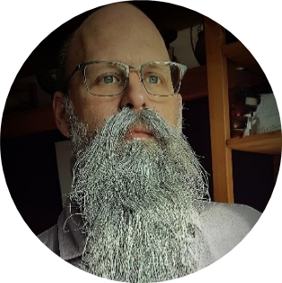
Contestants
John
Rob

Slide 3
Picture of old rebel bikers
Photo by Ricardas Brogys on Unsplash
Notes:
You can see that our beards are grey. So we are old. We are both consultants, working with various clients. We both love automation.
These are some of the tools that we use to make our lives easier.
If you wish to skip to the details – you can find them here
Happy with a beard.media link ?

Slide 4
THE PROBLEM WITH BEING OLD, you forget things!!
Photo by Ricardas Brogys on Unsplash
Notes:
You can see that our beards are grey. So we are old. We are both consultants, working with various clients. We both love automation.
These are some of the tools that we use to make our lives easier.
If you wish to skip to the details – you can find them here
Happy with a beard.media link ?

Slide 5
90
80
70
60
50
40
30
20
10
NEVER USE CURSORS

Slide 6
90
80
70
60
50
40
30
20
10
ALWAYS AVOID TRIGGERS

Slide 7
90
80
70
60
50
40
30
20
10
NEVER USE THE GUI

Slide 8
90
80
70
60
50
40
30
20
10
ALWAYS USE EXTENDED EVENTS

Slide 9
90
80
70
60
50
40
30
20
10
NEVER
USE
WRITE-HOST

Slide 10
90
80
70
60
50
40
30
20
10
ALWAYS AVOID FKs WITH CASCADE

Slide 11
90
80
70
60
50
40
30
20
10
It Depends!

Slide 12

Feedback Please
Good or Bad
Just tell us Why

Slide 13

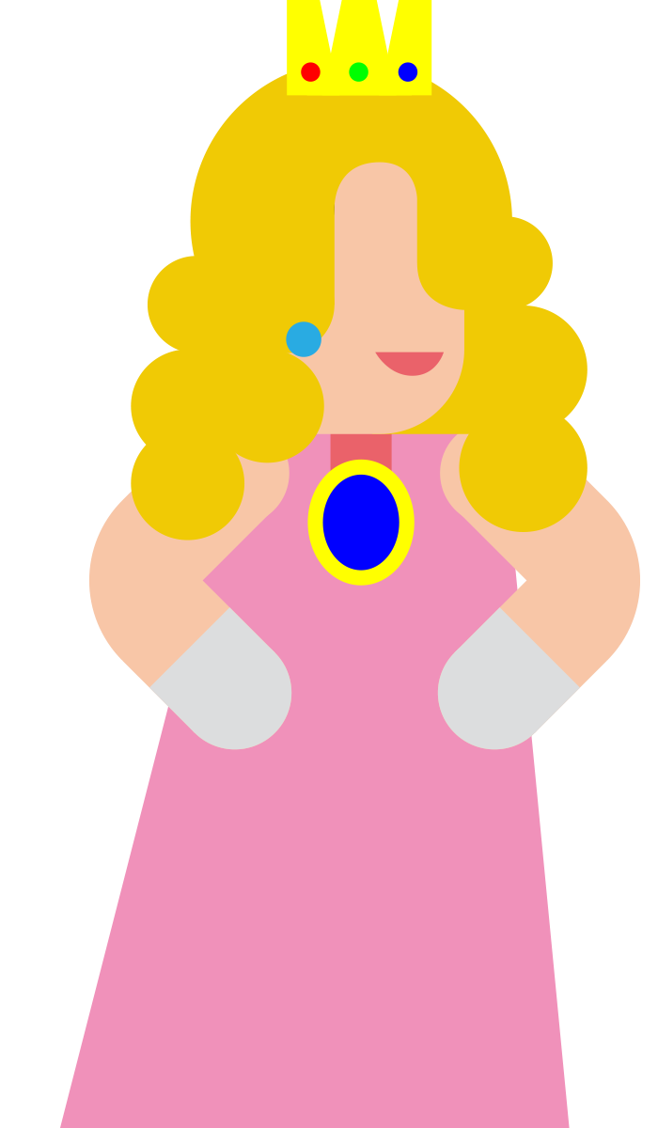


Slide 14
90
80
70
60
50
40
30
20
10
Countdown main – mess with it here and copy pasta

